Slide 1
Statement of service
Pastoral & Family support at Holbrook School for Autism

Slide 2
Our provision within school to ensure the physical and emotional welfare of our children and their families
Pastoral

Slide 3
The basic social unit consisting of parents and their children, whether dwelling together or not. Inclusive of step parents, carers, grandparents and extended family members
Family

Slide 4
Code of ethics
What are our values and ethos at Holbrook School for Autism?
A school value identifies something in-trinsically valuable or desirable for students and adults, which can be reflected in one's behaviour. Values articulate the moral and academic expectations for everyone in the school community, ensuring that every child who attends is aware of what the school aims to achieve for them. Furthermore, school values are instrumental in setting conduct standards and reinforcing the school's behaviour policy.
Our Values - The targets that guide us in our learning, our work and our life at Holbrook School for Autism
Have fun
Support others
Achieve more

Slide 5
Early help
Holbrook has developed its early help offer in line with demand and in conjunction with Esteem. Holbrook employs a family support worker 4 days a week and the aim of their role, as supported by our safeguarding and pastoral lead, is primarily ‘earliest’ help.
The role ensures family and student issues that arise on a daily basis can be resolved quickly and efficiently by a member of staff that has an in-depth knowledge of their needs and condition. Working closely with Esteem it also gives school the ability to now refer any tier two issues through the Multi Academy Trust - Esteem who allocate cases accordingly.
All tier three and immediate safeguarding concerns are advanced as before through social care.
As a school we are also holding a safeguarding day once every half term where there will be a break from normal timetables and the day will have a safeguarding focus in order for the whole school to receive an appropriate level of input from outside agencies.

Slide 6
Our pastoral support offer, empowers families with knowledge and skills
The offer

Slide 7
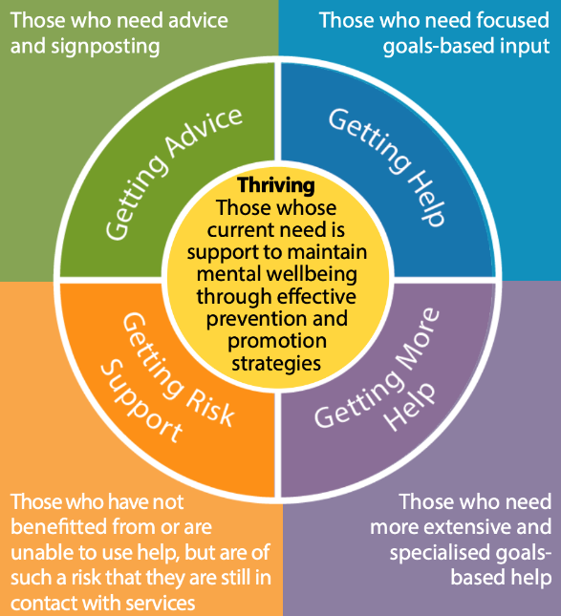
Our approach follows the Thrive model framework
This is an integrated, person centred and needs led approach to delivering support for children, young people and families. Thrive places an emphasis on prevention and early intervention.

Slide 8
What we provide……
Formal
Annual signposting event to bring together families and services face to face.
Attendance monitoring and assessment of need for further support where required.
Supporting the learning development of all staff in areas of safeguarding, medical and health needs.
Family forum to enable families to contribute towards the development of the school.
Completion of statements for external agencies, funding and benefits
Referrals to external services
Home visits to support transitions, learning and reintegration
External service workshops linked to key safeguarding themes
Safeguarding theme days across the pathways and curriculum and activities shared with families

Slide 9
What we provide……
Informal support
Cuppa and chat meetings once a half term held on site on our residential unit.
Telephone & email contact directly with families.
Theme events throughout the year to support families coming together, such as afternoon tea
Media
Seesaw communication
Webpage section
Signposting referrals to externals services support for health, housing social care CAMHS
Add photos of events – people taking part

Slide 10
Consulting with families
We encourage all parents/carers to engage with the school. Correspondence from school to home includes; school website; ParentPay; telephone conversations; annual review meetings; parent consultations; Seesaw; social media and termly newsletters.
We have parental governors on the governing body to ensure parents are represented within decisions made relating to the development of the school.
Where possible, parents are involved, through consultation, about changes in school through informal and formal discussions, and occasionally direct consultation. Parent questionnaires are sent out at least annually to gather parent views on the school’s effectiveness in different areas.
The school holds various open mornings; fayres; sports days; coffee mornings throughout the year to encourage parents to be actively involved in the wider school.

Slide 11
External organisations
FASST – Esteem Family And Student Support Team work with families and young people who attend one of our academies or one of the schools that have commissioned this service. We live and breathe the visions and values of our Trust and strive to ensure we evidence them in the support we provide to our communities.
Derbyshire Information, Advice & Support Service (DIASS) for Special Educational Needs and Disabilities (formerly Parent Partnership) provide free, impartial and confidential information to parents and children and young people on issues around education, health and social care, relating to special educational provision.
Occupational therapists; speech and language therapists; clinical psychologist; educational psychologists are commissioned by the school to provide their expertise and input into students individual programmes. There are regular meetings with the different professionals to ensure consistency of approach and most training opportunities are open to all extended team members.
Social workers may be allocated by locality or the disabled children’s team and their work with the school is based on each individuals/families requirements. The school also work closely with CAMHS and LD CAMHS to ensure students and their families get the correct support to promote emotional and behavioural wellbeing.
Transport to school is organised by the local authority, not the school. Transport staff are employed by the different transport companies.

Slide 12
Who to contact with concerns
Students are encouraged to talk to a member of staff if they are worried or concerned.
All of our staff receive regular safeguarding training and work in line with the most up to date legislation to ensure the safety and wellbeing of our students. Staff are trained to identify and raise any concerns which may affect the welfare of our students. Due to the differing needs of our students our staff may advocate on the students behalf if they have any concerns.
Visitors to the school are asked to read our safeguarding information to ensure they are aware of their duty of care to safeguard our students.
The safeguarding team is displayed throughout the school, including photographs of individuals, in an accessible format for all students and staff.
There is a link to Parent View on our website which directs feedback to Ofsted about our school.

Slide 13
LA’s Local offer
There is a link on our website to Derbyshire County Councils Special Educational Needs and Disabilities Local Offer. Derbyshire's local offer includes leisure and activity providers, health and care services, education providers and support groups.
The local offer simply aims to pull information about available services into one place and make it clear and accessible for families.
Holbrook School for Autism contributes to the local offer by providing education for special education for students with an EHCP and diagnosis of autism.

Slide 14
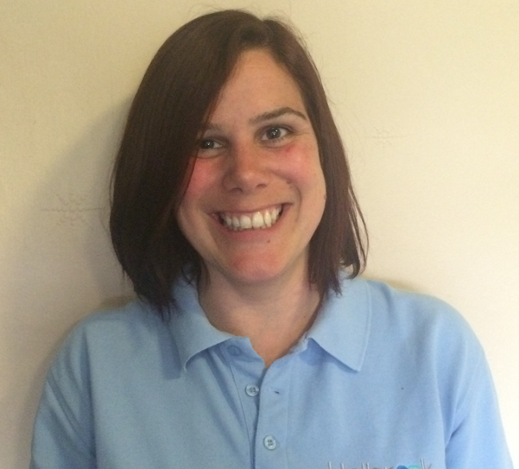
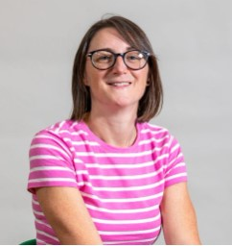
Our professional development
Kelly Thorne
Gemma Farrell
Kelly has worked at Holbrook School for Autism since 2001.
Kelly began her career at Holbrook within the residential unit and became the Head of Care in 2004.
Kelly’s skills within safeguarding were recognised as needing to be applied within the whole school and joined the SLT as the Head of Safeguarding and Pastoral in 2018.
Kelly is level 5 qualified in Leadership and Management and University Certificate in Autism.
Kelly is DSL trained and requalifies annually, along with being an active member of the local early help offer and attends regular training in relation to contextual safeguarding to ensure these practices are embedded within our school community.
Gemma has worked at Holbrook School for Autism since 2015. Working within a spectrum of roles, starting as a TA in the classrooms, to residential worker and then taking up the role of Family Support Worker in September 2019.
Gemma is level 4 qualified in Health and Social care and also has her Registered Managers Award.
Gemma is DSL trained and requalifies annually, along with attending all relevant safeguarding training and school training through our online system of Educare.

Slide 15
Parental experiences
“The school is very supportive and caring, and very approachable. My child had issues at home, so they arranged for FASST to come in, and referrals were made to the hospital as well. I am much more confident now about how to help my child. They help with supporting letters. They are very caring and respectful. Before my child started at the school, they visited us at home. We met the staff. Transition into the school was at our own pace. When my child was changing classrooms, they provided a social story, which helped us to talk about what would be happening next.”
“It’s a partnership with our family, team work. I can’t praise the team enough. The door is always open. The Seesaw app is really good. I can say my child is struggling, to forewarn his teacher. They message me back and say this is how we are going to deal with this. Teaching Assistants send us WOW moments.”
“The school is like a family. The Family Support Worker has started informal coffee and chats with parents in the local church hall. We share ideas about how to deal with problems. We find out about holiday activities. I have had help with toileting, and with brushing teeth. My children are more calm now, and can accept change. I get a daily update through Seesaw. They help with anything. Because of the help we have had, my children are happy to go to school.”
“Signposting events are really well-run and relevant. They ask us what we need. Agencies come in, including autism services, the Special Needs Circle, Sunshine, and even solicitors.”

Slide 16
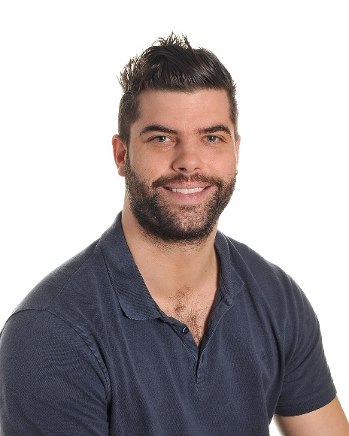
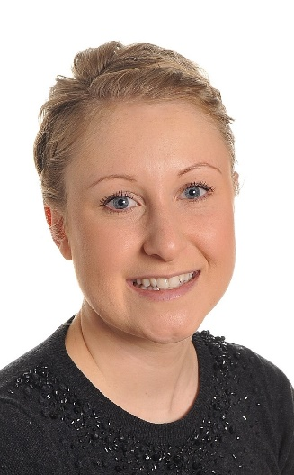
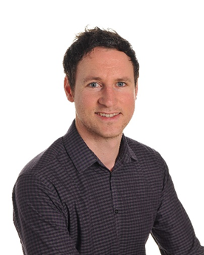
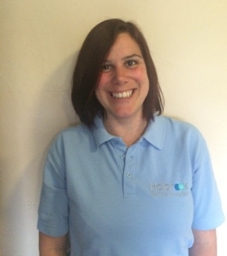
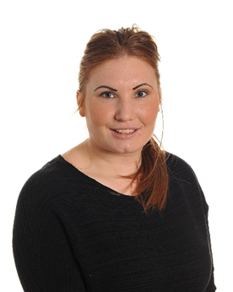
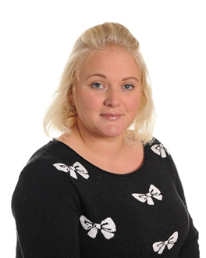
The Senior Leadership Team:
Sam Bayliss Headteacher
Lucy Hunt
Deputy Headteacher
Richard Jackson Deputy Headteacher
Kelly Thorne
Pastoral & Safeguarding Lead
Louise Story
Assistant Headteacher
Sally Petcher Assistant Headteacher

